Slide 1

SNAKE AND LADDERS
Submitted by : HITESH JOSHI

Slide 2
TABLE OF CONTENTS
INTRODUCTION
GAMEPLAY
IMPLEMENTATION
HEADER FILES
VARIABLES
FUNCTIONS
ALGORITHM
SNAKE AND LADDERS BOARD
OUTPUTS

Slide 3

INTRODUCTION
Snakes and ladders is a board game for two or more players regarded today as a worldwide classic. The game originated in ancient India as Moksha Patam and was brought to the UK in the 1890s.
It is played on a game board with numbered, gridded squares. Several "ladders" and "snakes" are pictured on the board, each connecting two specific board squares.
The object of the game is to navigate one's game piece, according to die rolls, from the start (bottom square) to the finish (top square), helped by climbing ladders but hindered by falling down snakes.
The game is a simple race-based on sheer luck, and it is popular with young children.

Slide 4

GAMEPLAY
Each player starts with a token on the starting square (usually the "1" grid square in the bottom left corner, or simply, off the board next to the "1" grid square).
Players take turns rolling a single die to move their token by the number of squares indicated by the die rolled.
Tokens follow a fixed route marked on the gameboard which usually follows an ox-plow track from the bottom to the top of the playing area, passing once through every square.
If, on completion of a move, a player's token lands on the lower-numbered end of a "ladder", the player moves the token up to the ladder's higher-numbered square.
If the player lands on the higher-numbered square of a "snake" ,the token must be moved down to the snake's lower-numbered square.

Slide 5

IMPLEMENTATION
HEADER FILES
#include<stdio.h>
#include <time.h> //TIME DELAY
#include <dos.h> //SLEEP FUNCTION
#include <stdlib.h> // EXIT , RANDOM FUNCTIONS
VARIABLES
Initializing an array int arr[100] with values, snakes, and ladders to print it as a board.
Declare and intialize int p the number of players and char playname[p][10] to store name of player.
Intialize int players[p] to store place of player after every throw with 0 values.
int dice to store random number generated by random functions.
int temp to store previous value of players.

Slide 6
FUNCTIONS
void winner(int *players, int i, int temp, char player_name[10]) to check if any player won or if the player value is greater than 100.
ALGORITHM
Start.
Enter number of players and their names.
Player will throw the dice.Outcome will add to the previous value/place of the player.
Call winner function to check if the player is at 100 .
If a ladder is encountered ,player will assign a new value/place greater than previous.
If a snake is encountered ,player will assign a new value/place less than previous.
Run steps 3 to 6 for all players.
Print the place of all players.
Run steps 3 to 8 until a winner is found.
stop

Slide 7
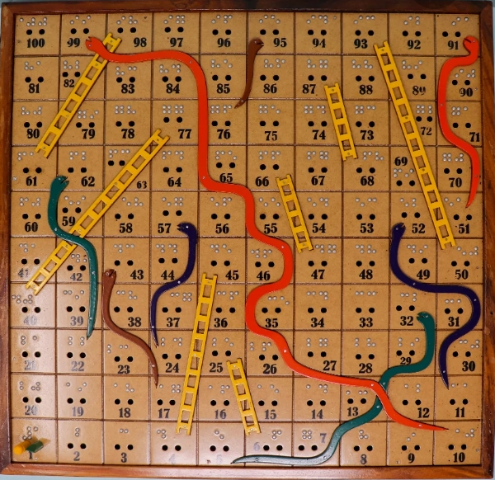
My program is based on the following snake and ladders board :

Slide 8
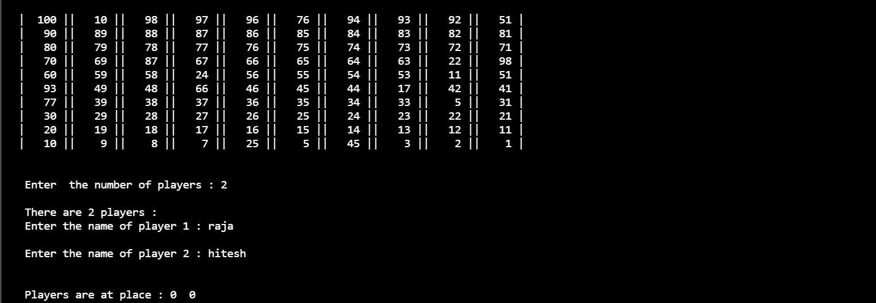
OUTPUTS
1.
Showing the board i.e arr[100] and values on it . If the values are greater than its index value it means that there is a ladder ( take position 4 where value is 45 means there is a ladder from 4 to 45 ) and if the values are less than the index value then it means a snake has been encountered (take position 99 where value is 10 means there is a snake from 99 to 10).
Also, enter the number of players as well as their names.

Slide 9
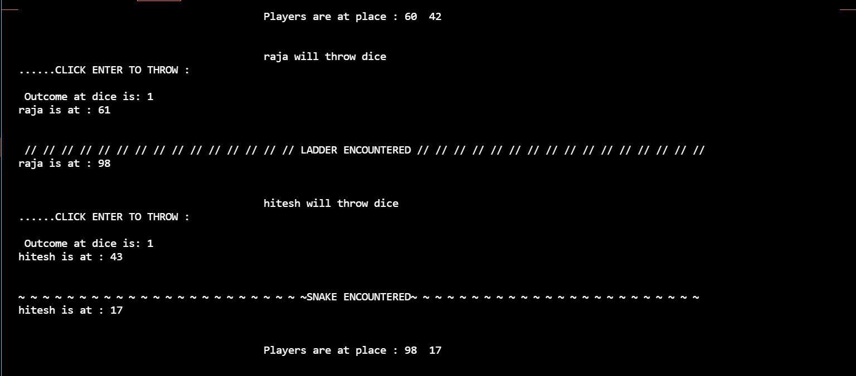
2.
SNAKE AND LADDER ENCOUTERED

Slide 10
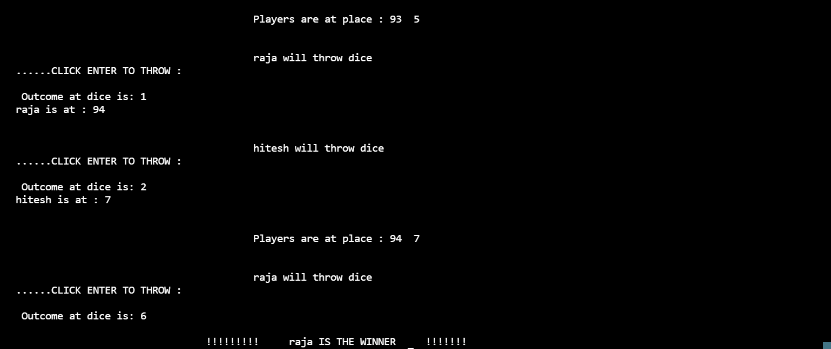
3.
The winner’s name is shown when the player is at 100 and the program terminates.

